Slide 1








Organizers: Fernanda Alves-Martins Javier Martinez-Arribas Thainá Lessa
Workshop
Using OpenRefine for pre-processing ecological data

Slide 2
Principal features
Free desktop application that uses your web browser.
Does not modify your dataset.
Save as you go.
Can reply cleaning steps on multiple projects.
Provides overviews of the dataset and helps resolve inconsistencies.
For small to mid-size datasets (< 50k).
Notes:
the choice of the type of data used in each study depends on:
– (a) the quality and quantity of available data
– (b) the purpose of the study

Slide 3
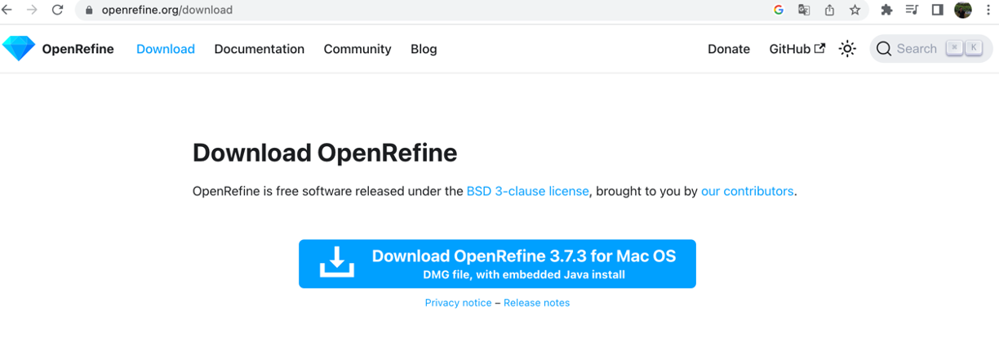
Installation
Go to https://openrefine.org/download
Download and unzip the installation file. (Maybe you want to install java manually before from https://adoptium.net/es/temurin/releases/)
Notes:
A mais importante dessas iniciativas é, sem dúvida, o Global Biodiversity Information Facility (GBIF), iniciado em 2001 (Edwards, 2004). O GBIF aproveita os esforços coordenados e contínuos de longo prazo para digitalizar espécimes das coleções de história natural do mundo (Nelson & Ellis, 2019).
De acordo com a maioria das medidas, o GBIF tem sido um sucesso notável e atualmente hospeda mais de dois bilhões de registros de ocorrência de espécies de mais de mil instituições (GBIF, 2022).
O GBIF é uma rede internacional e infraestrutura de pesquisa que fornece acesso aberto a dados de biodiversidade. O GBIF foi criado em resposta à recomendação do Megascience Forum da OCDE em 1999 e, desde a sua criação em 2001, cresceu para incluir mais de 1 bilhão de registros de ocorrência de espécies e 41.000 conjuntos de dados. O GBIF é relevante para as metas de Aichi, pois o crescimento no número de registros é um indicador do BIP (metas 9,11,12,13 e 19). Globalmente, conforme observado por (Bingham, et al., 2017) e o BIP (2018), aumentar as conexões entre as diferentes plataformas de informação e organizações a nível global será importante para melhorar a capacidade de recolha de dados e a sua utilização no rastreamento progresso rumo ao quadro pós-2020, a nível internacional e nacional.

Slide 4
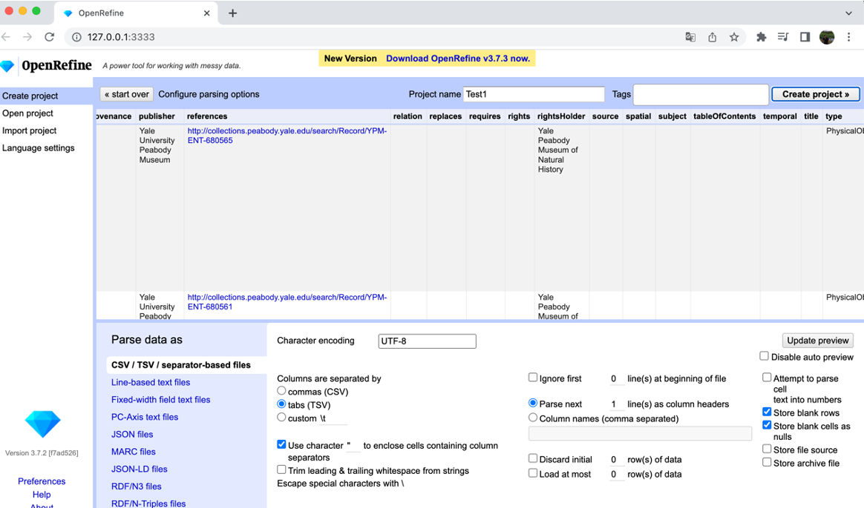
Creating a project
First of all we will have to select the file where our data is located:

Slide 5
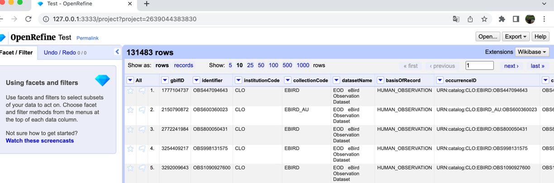
Creating a project
When a preview of the data appears, we will add the name of the project, the type of parsing, the encoding (UTF8), unselect "store blank rows" and press the button to create project.

Slide 6
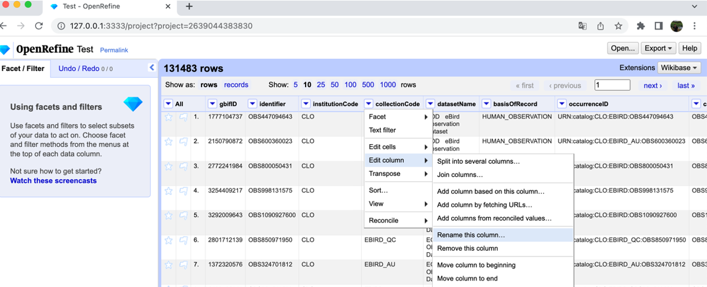
Data processing
Changing column names. The column dropdown menu:

Slide 7
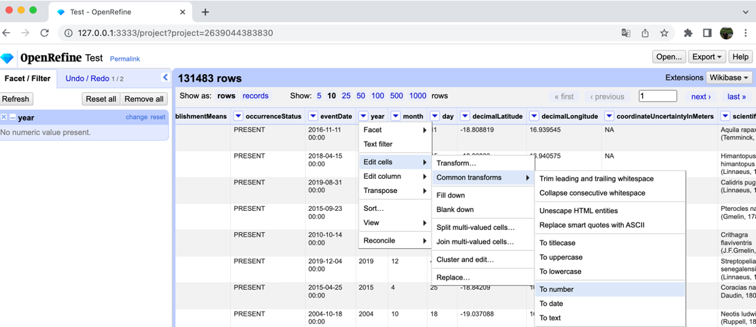
Data processing
Outliers and NAs:
Maybe we need to transform the data format first:
Notes:
Temporal:
Além disso, mudanças temporais na cobertura espacial das pesquisas resultam em dados espúrios sobre mudanças nas distribuições ao longo do tempo (Lobo et al. 2007, Hortal et al. 2008), afetando nossa capacidade de identificar mudanças de alcance anteriores (Huisman & Millar 2013) e determinar padrões atuais de extinção (Lobo 2001).

Slide 8
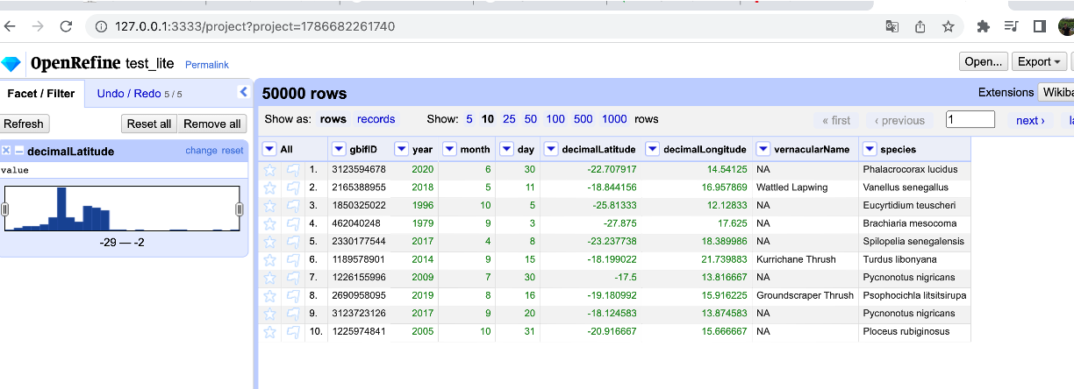
Data processing
And now, looking for the range of values in the transformed feature:
We see that there are values bigger than -16 degrees for latitude feature.
It is necessary to filter out values smaller than -29 or bigger than -16 degrees.
Notes:
The accuracy of any analysis or prediction depends on the quality of the original data.
These decays account for the progressive loss of value of data to predict biodiversity trends at increasing distance from the observations
The decay of biological information with time and space comes about because species are continuously responding to ongoing environmental changes. Changes over time include climate change, land-use change, habitat degradation, and biological invasions
Changes in space include climate, habitat type, soil chemistry, level of disturbance, and community composition.
Taxonomic:
Many groups and species receive more studies and investments than others
Changes in the taxonomic process and incorrect taxonomic identification
Space:
Some regions or habitats are more sampled than others
Lack of knowledge about species geographic range
Impediment to make reliable previsions on species distribution modelling
Temporal:
Large part of data is out of date
Habitat degradation, changes in land cover and climate changes tend to modify species assemblages

Slide 9
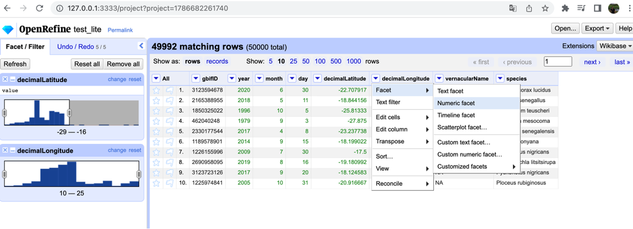
Data processing
And make the same for the longitude values. Filtering out values smaller than 10 and bigger than 25 degrees using a facet as well:
Finally as you can see we discard 8 samples.
With facets menu we can find outliers and NAs, and filter out them as easy as moving the range of values over the plot.

Slide 10
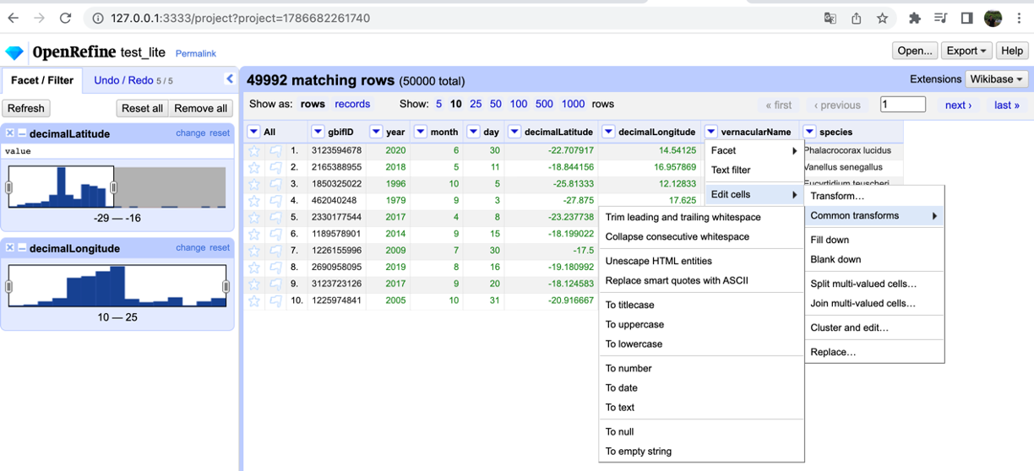
Data processing
Mispelling and text transformations:
One of the most powerful tool of OpenRefine is how it can deal with spelling errors. Before starting, it is a good practice triming leading and trailing whitespaces, collapse consecutive whitespaces and coverting to lowercase all text columns.

Slide 11
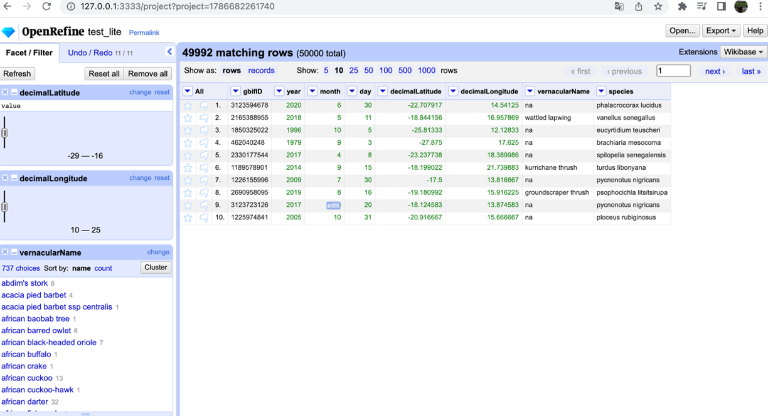
Data processing
In order to deal with spelling errors we have inside the text facet menu, the cluster button:

Slide 12
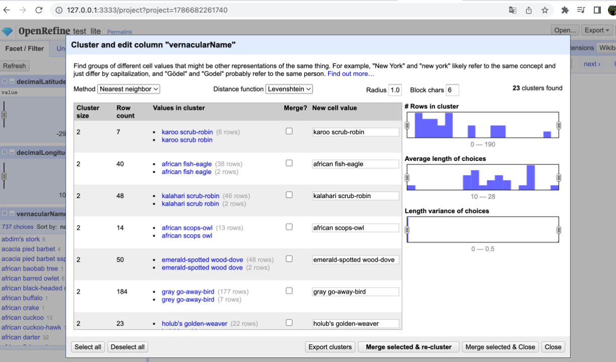
Data processing
You can test with the two methods available, “Key collision” and “Nearest neighbor”, and even tune its hyperparameters:

Slide 13
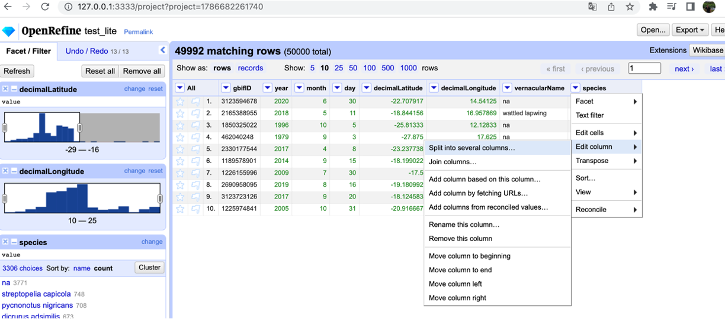
Data processing
Sometimes we need to split a text column in several different columns:
Notes:
Trained taxonomists
Experts
Amateurs

Slide 14
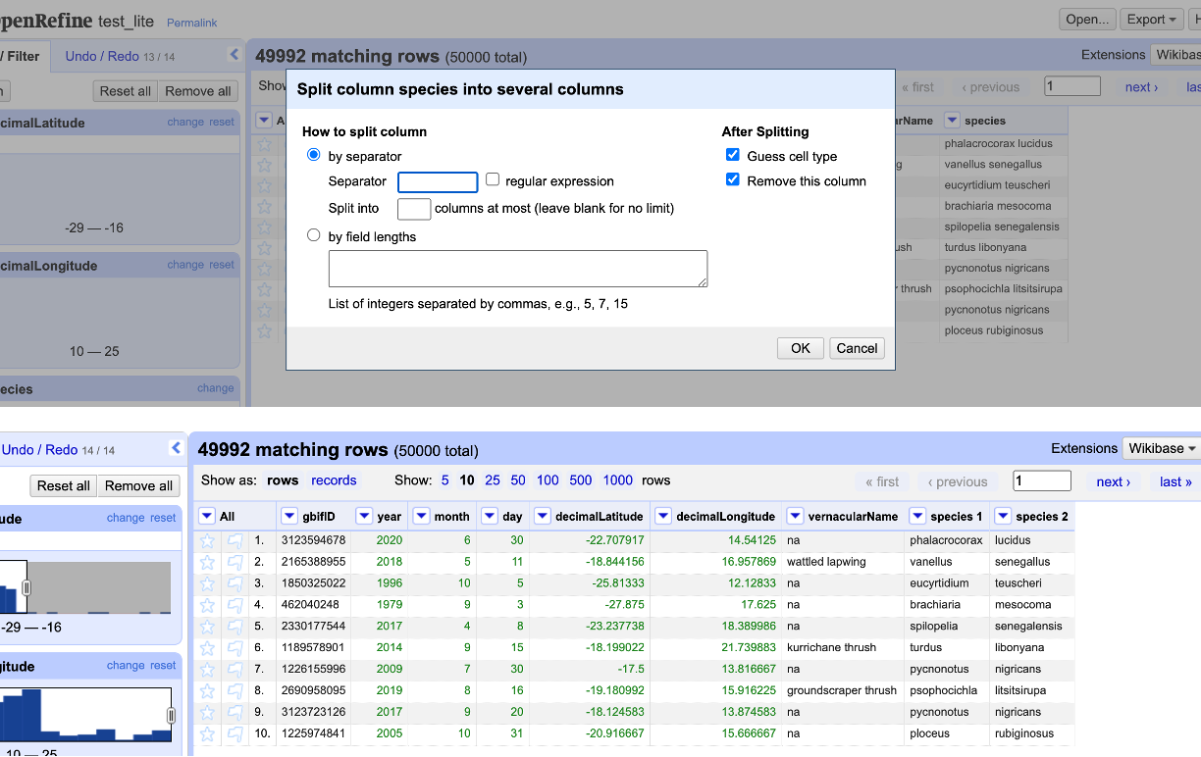
Data processing
Select the separator by which we are going to divide the column and accept:

Slide 15
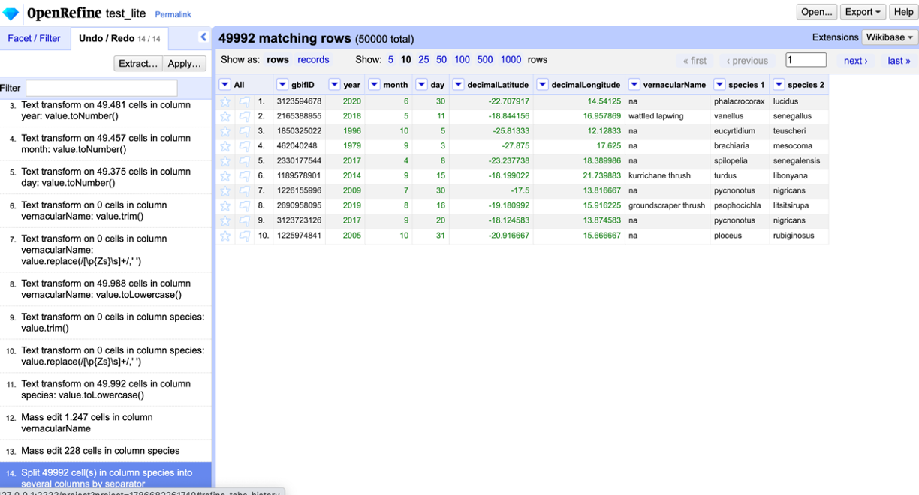
Data processing
Remember that we can come back and undo all changes that we want just going to the Undo/Redo tab:

Slide 16
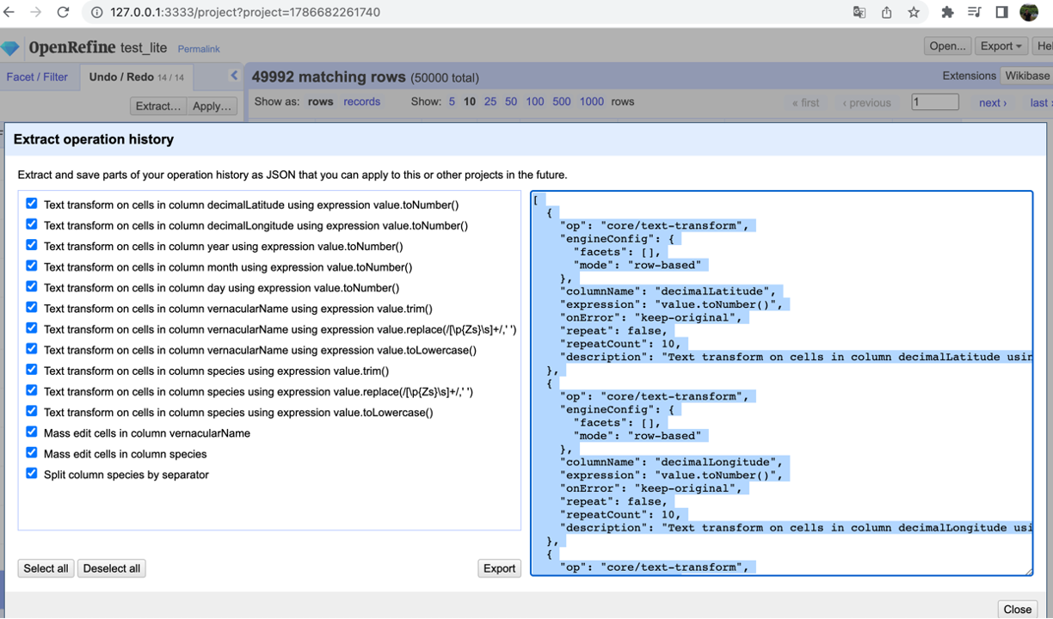
Data processing
In this tab we have the “Extract” button in order to apply (“Apply” button) all the changes that we have done to other files or datasets. (p.e: smaller splits of the big dataset):

Slide 17
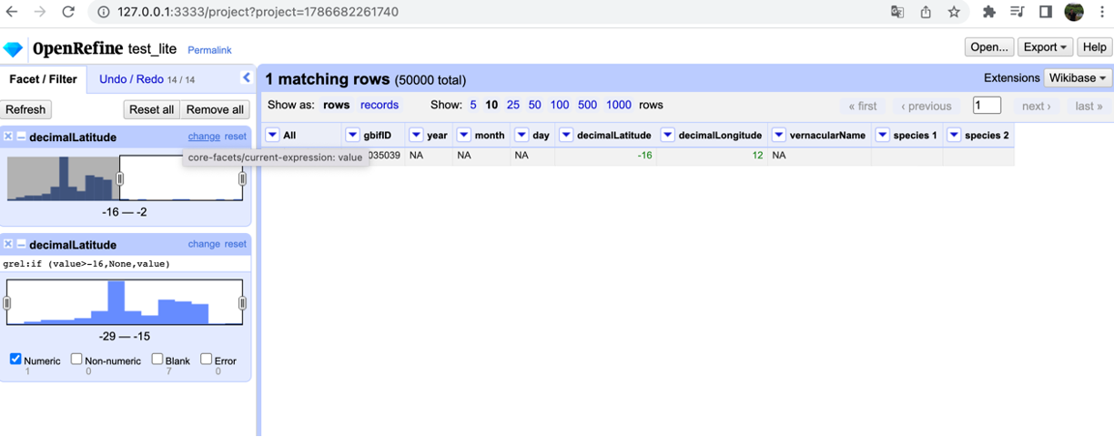
Data processing
For filtering, there exist several methods:
Text filter menu.
Text facet / numeric facet >> include / exclude value.
Custom facet.

Slide 18
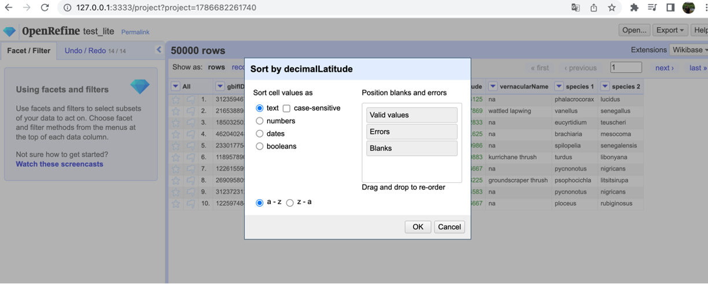
Data processing
For sortering we can use the sort option inside the dropdown menu:
We can chose putting errors and blanks at the beginning in order to edit them easily.

Slide 19
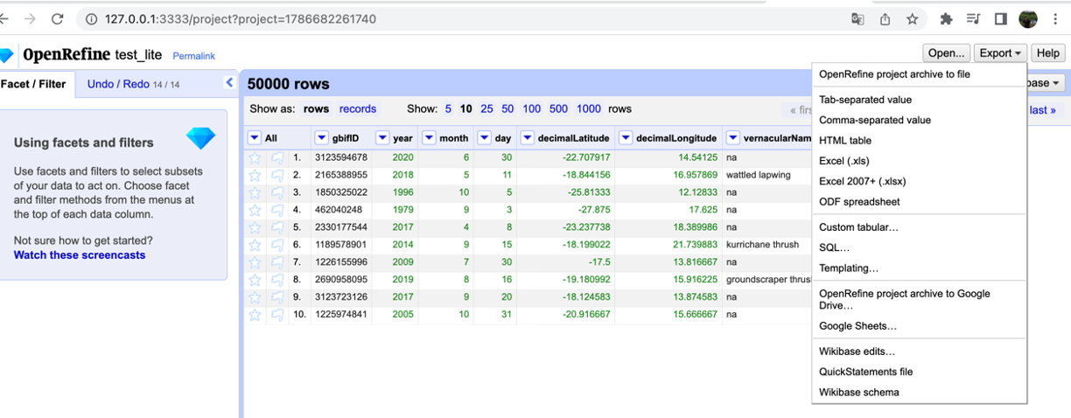
Data processing
Exporting the final result is as simple as pressing the ”Export” button and select the option that you prefer:
With OpenRefine you can share both the final dataset and all processing steps.

Slide 20
Fernanda Martins - ferfealvesmartins@gmail.com Javier Martínez - javimartinezarribas@gmail.com Thainá Lessa - thainalessaps@gmail.com
Thank you!
Merci!
Murakoze!
¡Gracias!
Obrigado!

